Slide 1

https://event.ithu.tw/2024030124
要報名喔!
我會點名(同時加分)!
https://www.youtube.com/watch?v=T1UiAryp5MA
https://www.terasoft.com.tw/videos/Online_Teaching_and_Virtual_Labs_with_MATLAB_and_Simulink.asp
https://www.terasoft.com.tw/academia/MATLAB_tutorials.asp
https://www.terasoft.com.tw/academia/classroom_resources.asp

Slide 2
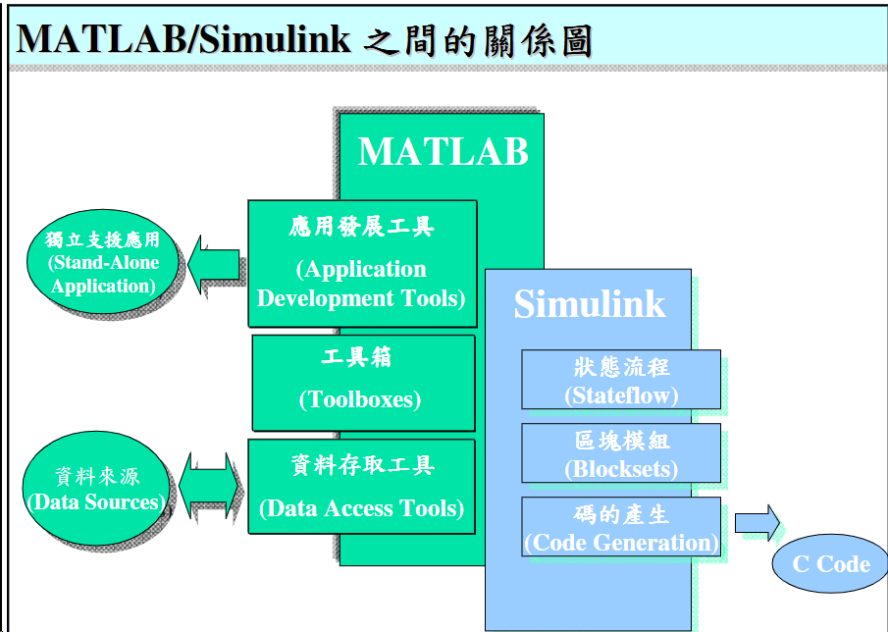

Slide 3
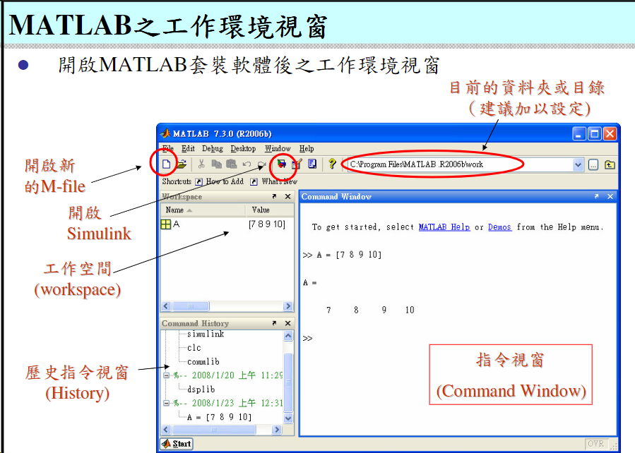

Slide 4
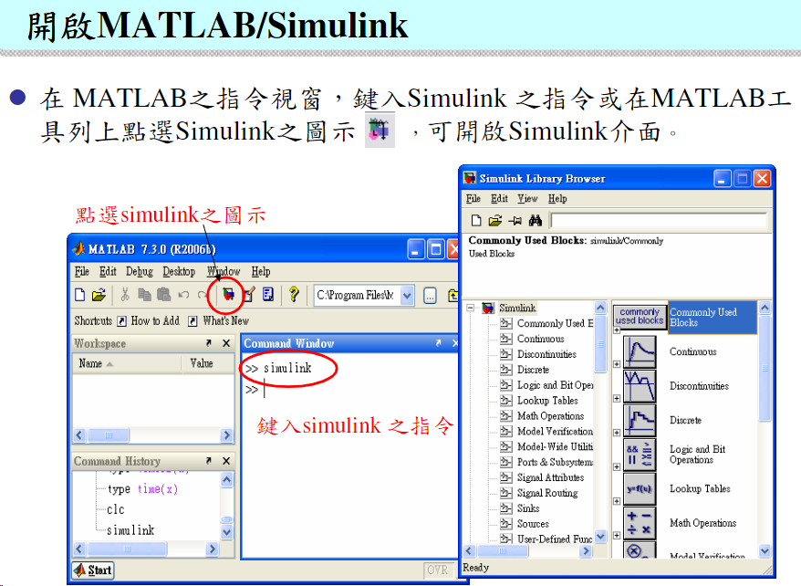

Slide 5
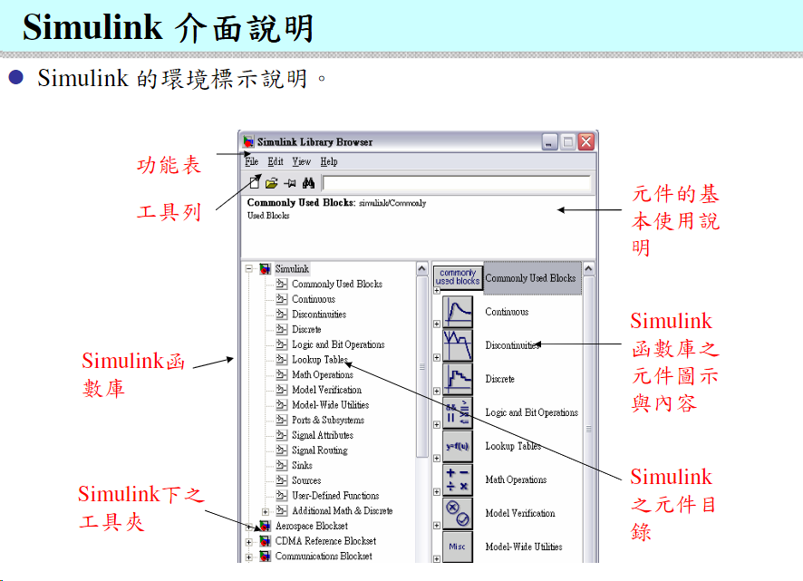

Slide 6
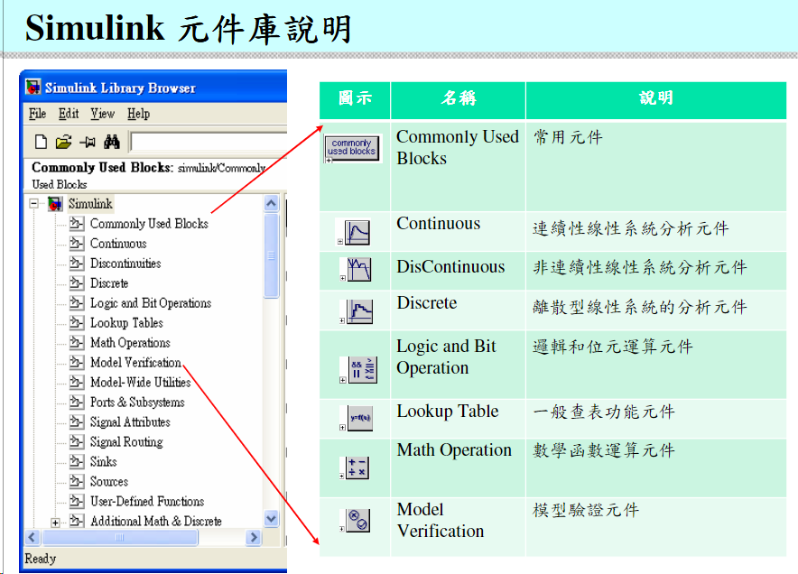

Slide 7
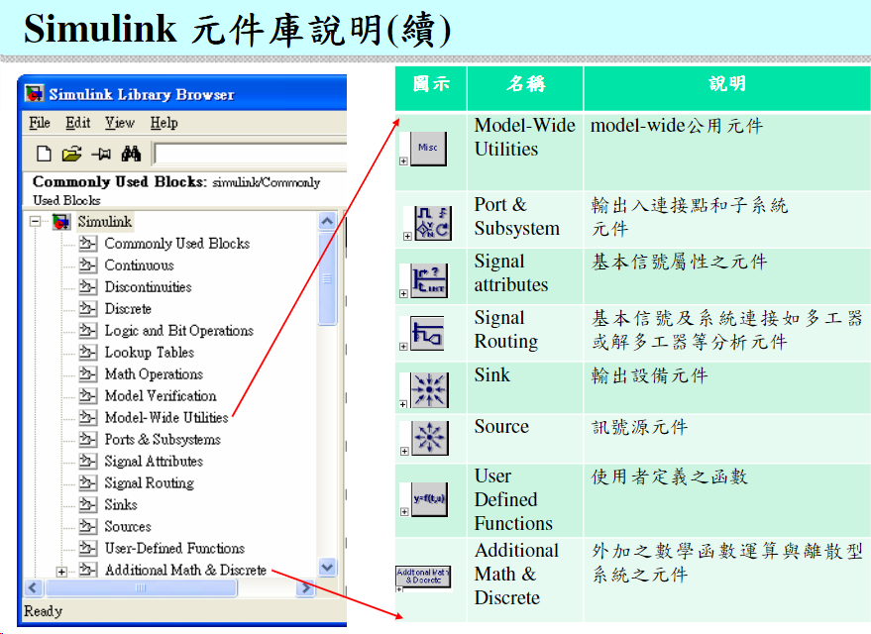

Slide 8
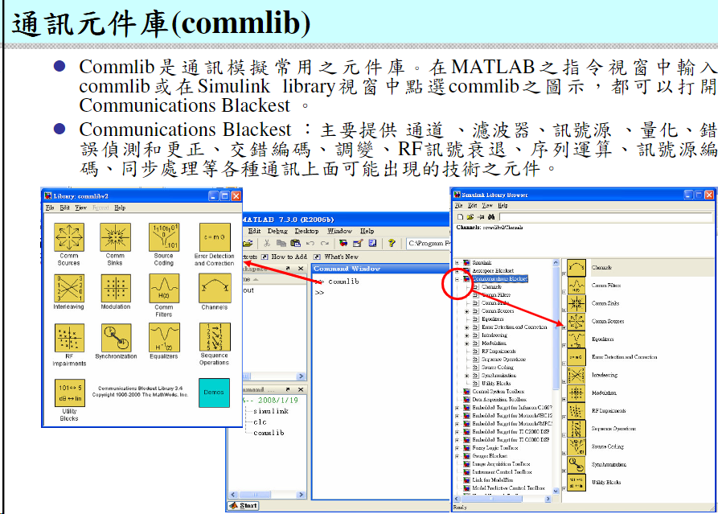

Slide 9
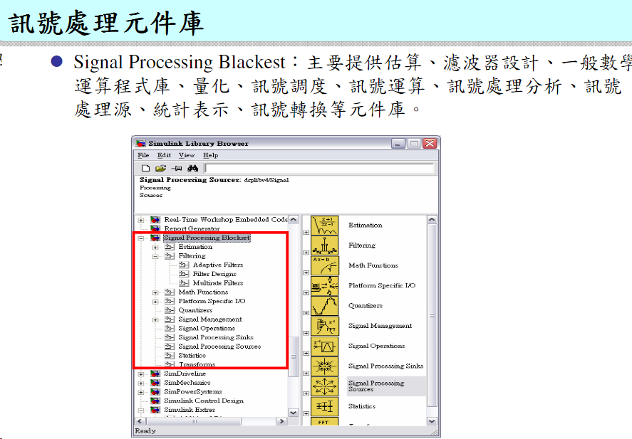

Slide 10
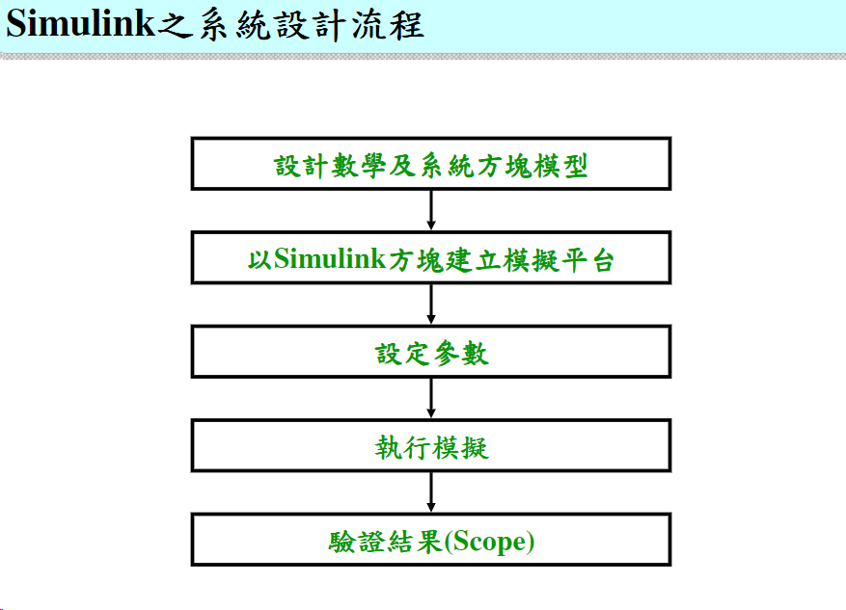

Slide 11
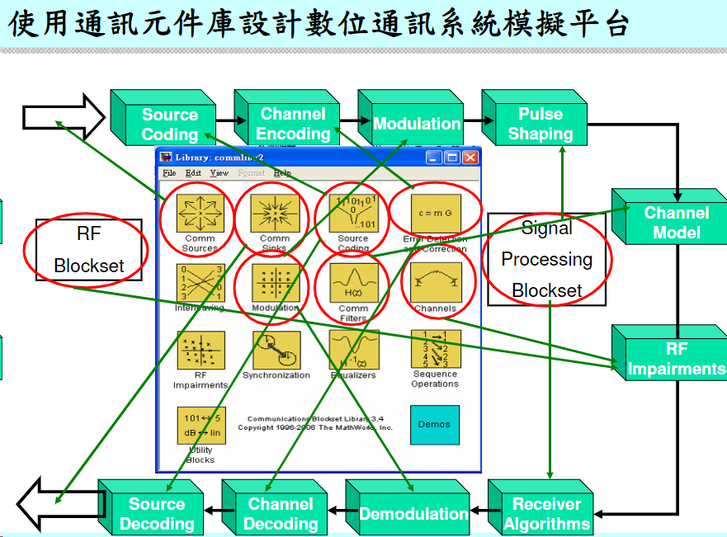

Slide 12
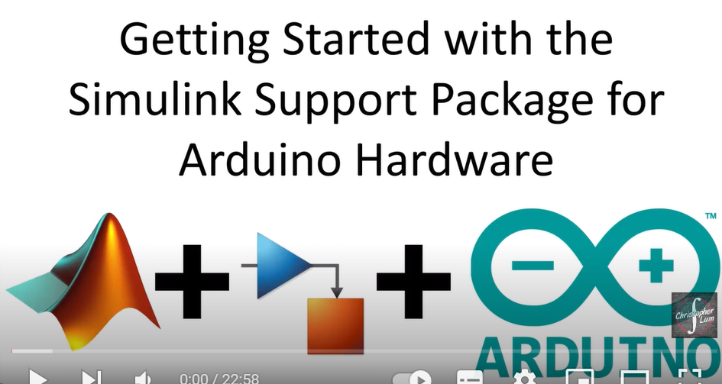
當Arduino遇見Matlab
https://www.rs-online.com/designspark/chi-blog-matlabarduino

Slide 13
https://blog.cavedu.com/2013/09/27/%E7%95%B6arduino%E9%81%87%E8%A6%8Bmatlab/
https://www.mathworks.com/videos/programming-arduino-uno-with-simulink-86316.html
https://www.youtube.com/watch?v=nOz3uTi20Jo
https://www.mathworks.com/discovery/arduino-programming-matlab-simulink.html
https://www.mathworks.com/videos/using-arduino-with-matlab-and-simulink-100477.html
https://micro.rohm.com/tw/deviceplus/how-tos/arduino-guide/arduino-dsp-intro-to-digital-signal-processing-using-matlab-part-1/
https://read01.com/zh-tw/oALdOe.html

